Slide 1
Milestone 2 Presentation
Shane Wild
Jonathan Pass
Lily Lama-Solet
Grant Richardson
Brandynn Daugherty

Slide 2
Agenda
Milestone 2 summary.
Different methods.
Experiences, challenges, and progress.
Milestone 3 preparation.

Slide 3
Milestone 2 Summary
Google Sheets reading is functional.
Matchmaking algorithm is functional.
Can find players ranks using Riot API.

Slide 4
Google Sheets Reading
Read method is capable of taking in a range value through a slash command.
By default, it will read from the first sheet unless a different sheet is specified.
The data is displayed in an embed that is styled with KSU iconography.
The first time accessing a Google Sheet, a gmail account needs permission to access it.
This permission is stored as an access token after the first access.

Slide 5
Riot API
Got access to the Personal Riot API key.
Method which will take a username and return the players rank and other statistics.
These stats can be turned into a tier which will be used for the matchmaking algorithm.

Slide 6
Matchmaking Algorithm
Finds all teams for 10 players where each player is playing their preferred role(s).
Sorts them by which is the most fair for all players using: score=(t1_{top laner​} − t2 _{top laner})² + (t1 _{mid laner} ​− t2 _{mid laner})² + (t1_{bot laner}​ − t2 _{bot laner})² + (t1 _{jungle}​− t2 _{jungle​})² + (t1 _{support ​}− t2 _{support}​)²
Once all possible teams are formed, we can pick the lowest score for each match.
Matchmaking for 20,30,40.. players was difficult to implement, we will sort more than 10 players by tier then feed them into the 10 player matchmaking algorithm.

Slide 7
Milestone 2 Challenges/Experiences
The Google Sheets read method was difficult to implement due to a lack of similar, more complex functionality.
Discord’s embeds have limitations that prevent the bot from displaying a lot of information.
Matchmaking for more than 10 players is difficult to code, as well as would be very slow to brute force.
Discords api is tricky to work around and what actions can be performed on a coroutine is not possible.

Slide 8
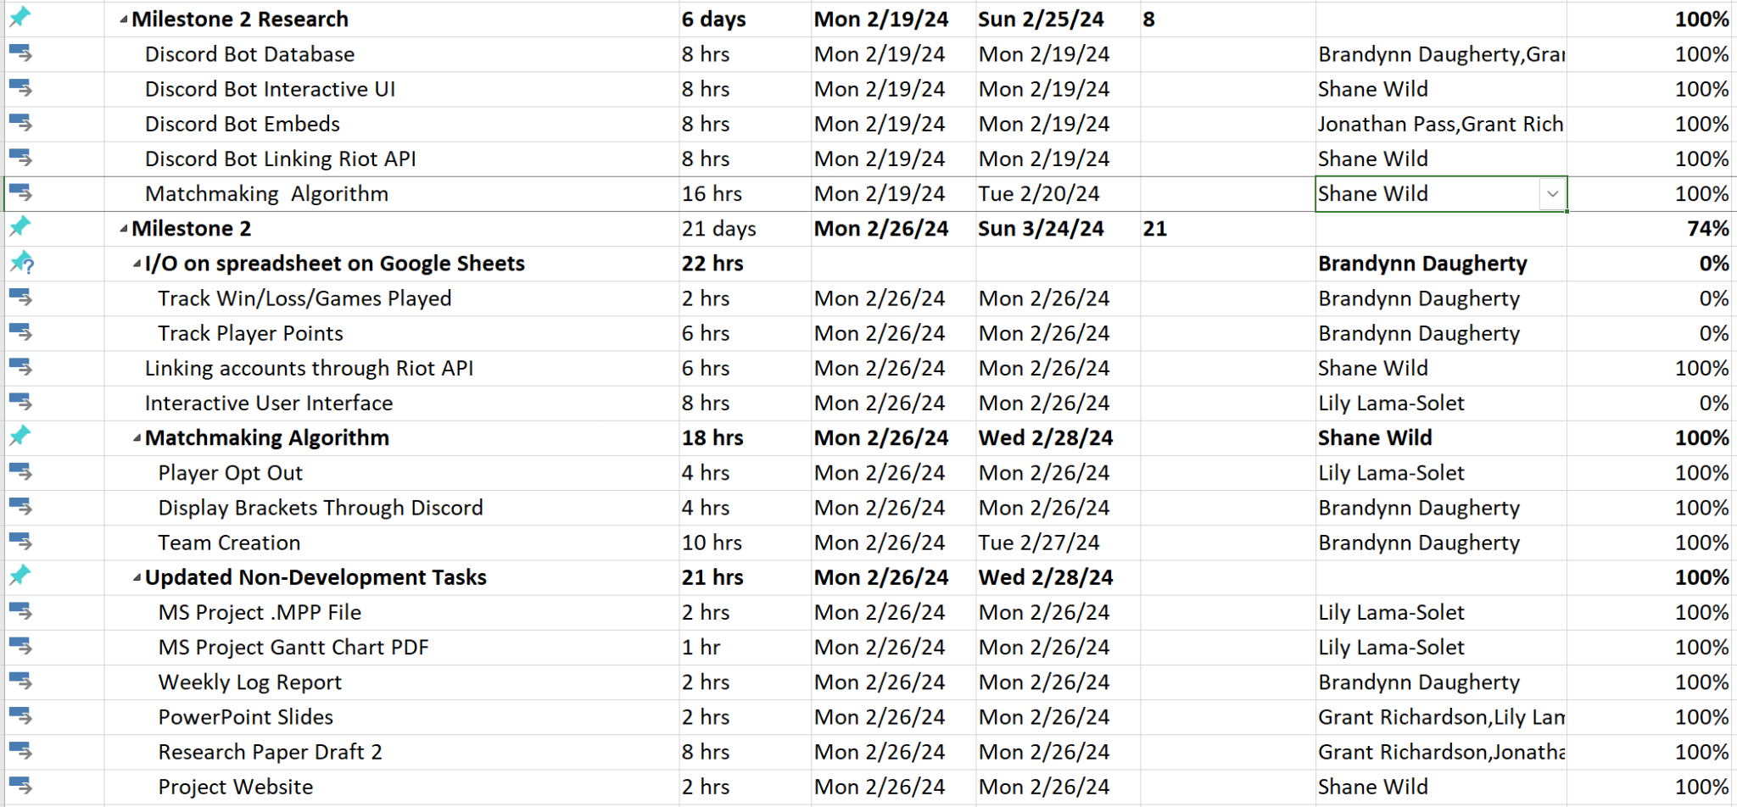
Gantt Chart

Slide 9
Member Contributions
Brandynn Daugherty
Set up and implemented Google Sheets read method.
Troubleshooted Google Sheets read method connectivity and embed display.
Shane Wild
Applied to and used Riot API to get players rank.
Worked on matchmaking algorithm.
Debugged the Google Sheets and embeds.

Slide 10
Member Contributions cont.
Lily Lama-Solet
Worked on fixing issues with the bot not invoking commands properly
Troubleshooted discord embeds
Grant Richardson
Worked on second draft of the research paper
Jonathan Pass
Command Parsing: Using discord.py, the bot identifies messages containing the "/mvp" command and extracts the player's name.
Error Handling: Prevents duplicate votes and enforces integrity.

Slide 11
Milestone 3 Preparation
Put all the methods together (matchmaking, Riot API, Google Sheets) and finish any loose ends.
Use embeds to display lobby one teams, lobby two teams, and the players who volunteered to sit out.

